Slide 1
Unlocking your child’s future through reading

Slide 2
Why do we teach reading?
“Reading is important, because if you can read, you can learn anything about everything and everything about anything. ” -Tomie DePaola
“There is no such thing as a child that who hates to read: there are only children who have not found the right book.” Frank Serafini
You can find magic wherever you look. Sit back and relax all you need is a book!”
Dr. Seuss
Notes:
Ask the families what is reading?
Why do we teach it?
What skills does it give your child?
How does it impact on them in their wider life?
What difference will it make to them as adults?
Reading is Fundamental. In fact, it is one of the most important ingredients to becoming all that you can be.
Reading develops your brain, provides a window into the world around you and helps you do better in all school subjects.
Most importantly, reading can not only help you become a better student, but a better person. You can learn from the brightest people whenever and wherever you choose.

Slide 3
What does it mean to ‘be’ a reader?
Notes:
Gain feedback and share the HPS vision about our understanding that Being a reader is a child that engages with texts and can demonstrate a variety of reading skills.
Someone that acknowledges how reading can influence and impact on the wider areas of their life and particualry the links eith other language events.

Slide 4
Highlands Primary School Vision
Our English curriculum promotes a love of reading and language, where our children understand the reasons and purpose behind reading and language in the wider world.
Language allows opportunities for children to reflect and question what they read and hear, using their critical voice.
Our children will be nurtured to become lifelong imaginative and creative readers, writers, speakers and thinkers who can use this language power to challenge and question the world around them.
Reading is a true plank of social justice and levelling the playing field of society for our children.
Notes:
Gain feedback and share the HPS vision about our understanding that Being a reader is a child that engages with texts and can demonstrate a variety of reading skills.
Someone that acknowledges how reading can influence and impact on the wider areas of their life and particualry the links eith other language events.

Slide 5
Issues we are facing within the classrooms
Children are not reading enough at home, this has impacted their comprehensive skills as they are struggling with understanding the meaning of texts.
Children are not getting enough opportunities to listen to stories read to them. It is important for children to hear stories read aloud as this is where they hear good modelling of decoding, fluency and intonation.
Reading enables us to build a richer vocabulary, as children are not reading a range of books they are unable to expand their vocabulary and develop their language and spellings.
Children should be reading a wide range of texts and be exposed to different authors. They should also be familiar with information texts as this will enable them to access content across the curriculum.

Slide 6
How can you make reading a positive event and unlock your child's reading skills at home
Read to your child
Listen to your child read
Ensure your child is reading for pleasure for 20 minutes per day (It doesn’t matter what they read!)
Ask your child to summarise what you read with them previously or what has happened in the text so far.
Visit the local library/make family reading time a part of your week!
Discussion time
Talk to them about your most enjoyable books and where & when you like to read. So they see reading as a part of life in their most important adults life!
Encourage them to predict using their given information from the text, cover, blurb.
Model your thinking process when reading.
Ask them questions about the text that link to reading skills –
What impression do you get, Why has the author.., What do you think? How do you feel about? Has your opinion changed? Does this remind you of any other text? What does that word mean? How does your experience of the world help your comprehension of this text?
Notes:
Firstly not through test practise!
This will have the opposite impact on your child if not completed in a safe and motivating environment.
Discuss the dialogic approach to reading.
Talk to them about your most enjoyable books and where & when you like to read. So they see reading as a part of life in their most important adults life!
Encourage them to predict using their given information from the text, cover, blurb.
Model your thinking process when reading.
Ask them questions about the text that link to reading skills - What impression do you get, Why has the author.., What do you think? How do you feel about? Has your opinion changed? Does this remind you of any other text? What does that word mean? How does your experience of the world help your comprehension of this text?

Slide 7
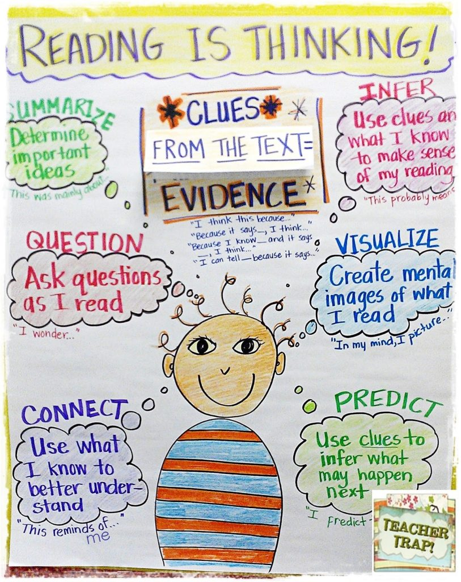
Skills of reading

Slide 8
the 3 question model
Looking: what colour is the sky?
(Comprehension)
Clue: Do you think it will rain?
(Comprehension)
Thinking: Does it matter?
(Inference)
The three questions are a springboard for a discussion
Prompt – probe
Problem-solving through talk
Notes:
Weekly structure Text marking, what we know what we think we know/ focus on vocabulary/relevance/ cause and effect/ questions
Questions should be designed to provoke discussion and dig into the meaning of the text – needs to be thought through.

Slide 10
Looking Question: What was Topher watching at the window?
Clue Question: How is Topher feeling when he yells at his Dad:
‘Who do you think I am? Why can’t you help me?’
Use evidence from the text to justify your answer.
Thinking Question: EMPATHY.
‘Nobody noticed when he did anything good, only when he was bad. Or they thought he was bad…They all thought he was a thief.’ Have you ever felt misunderstood? What advice would you give to Topher in this situation?

Slide 11
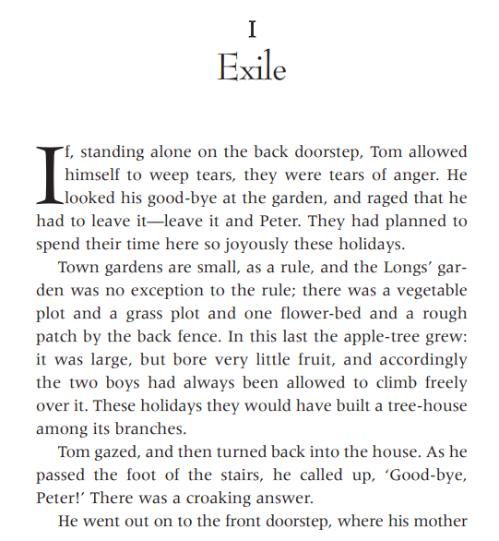
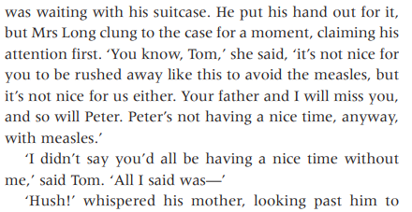
Notes:
LQ – How did Mrs Long ‘claim his attention’
CQ – How is Tom feeling? How do you know?
How is his mum feeling? Why does Tom say goodbye to the garden? How is mum trying to make Tom feel? TQ) Who do you think Peter is? What would you say to Tom?

Slide 12
Read with your child
How do you think this approach could impact your child’s reading?
What challenges might you face?

Slide 13
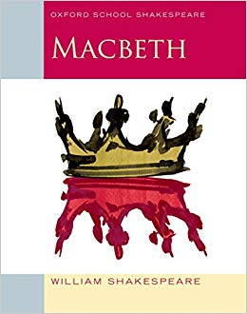
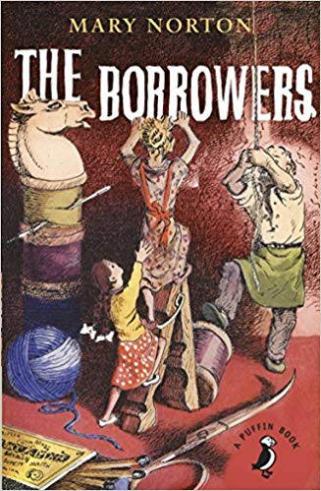
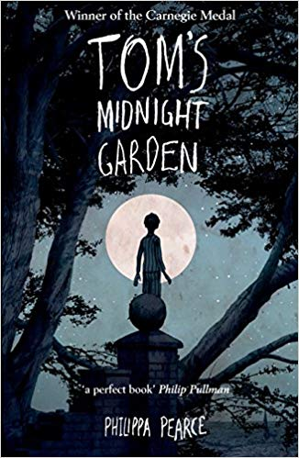
https://schoolreadinglist.co.uk/reading-lists-for-ks2-school-pupils/suggested-reading-list-for-year-5-pupils-ks2-age-9-10/
Notes:
Suggested YA novels.

Slide 14
Any questions?

