Slide 1

Reading and Writing Workshop
Year 3

Slide 2

The Importance of Reading
With effective reading skills, learning becomes easier.

Slide 3
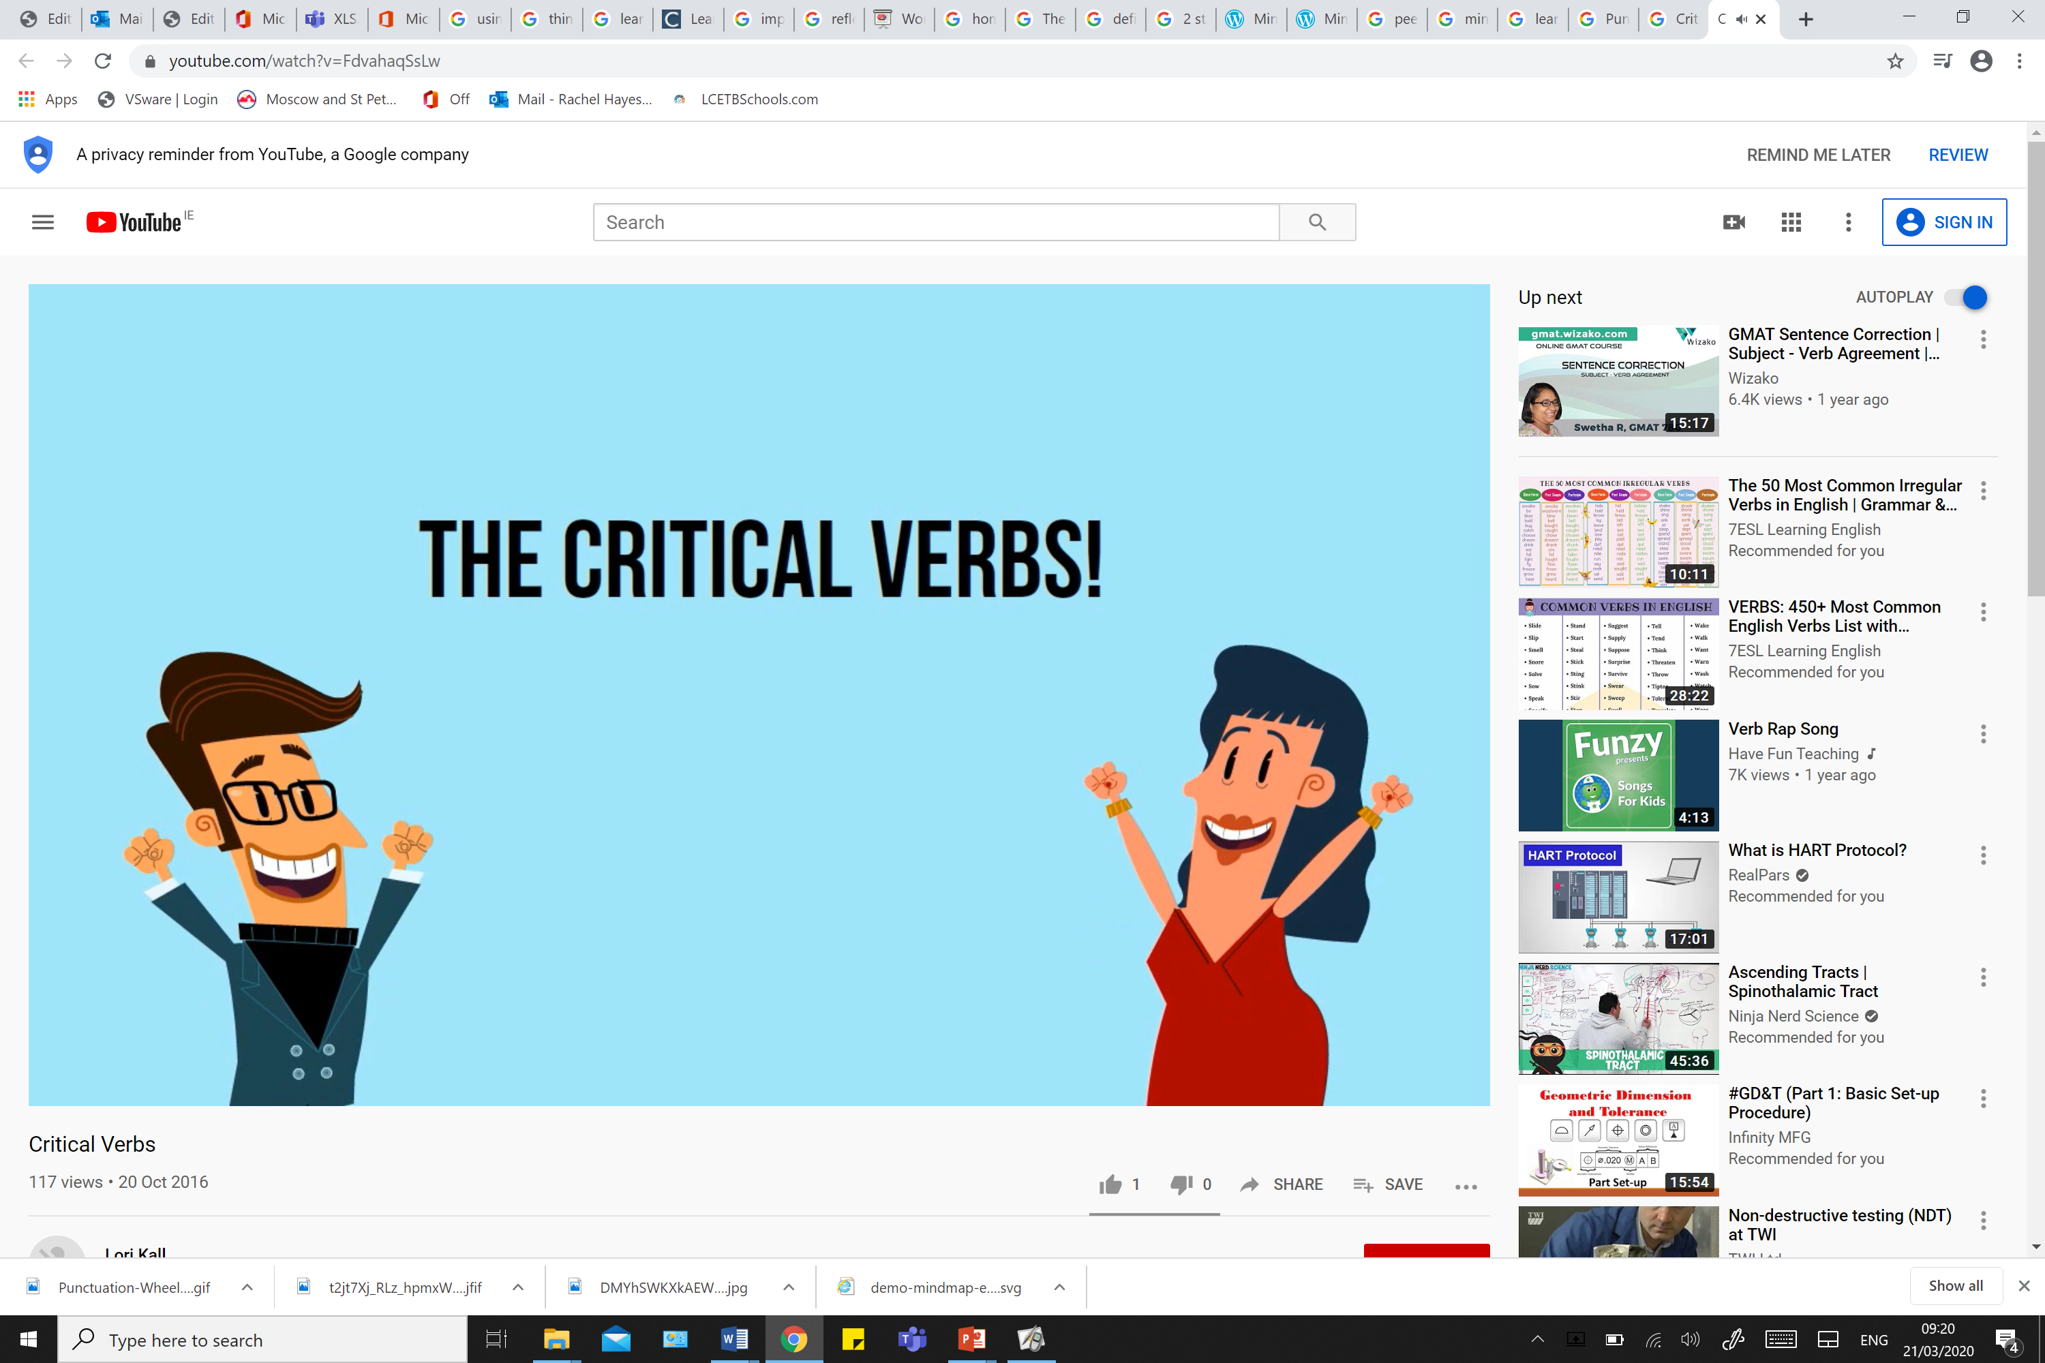

If we understand exactly what is being said and what we are being asked to do, we can answer more effectively and give better, more focused responses!

Slide 4

Reading opens up the world, allowing you to travel from home

Slide 5


Slide 6

Reading can improve your vocabulary which helps you express yourself more effectively and therefore answer questions in the best way.

Slide 7

Put simply…
Reading can help us become better people and better learners, that can communicate with others and understand the world in a deeper way

Slide 8
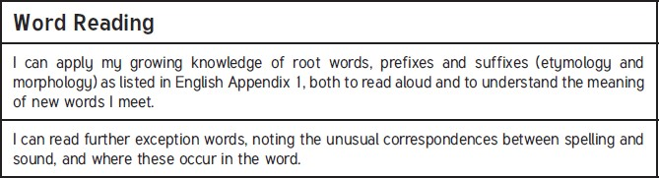
Lower Key Stage Two Year 3

Slide 9
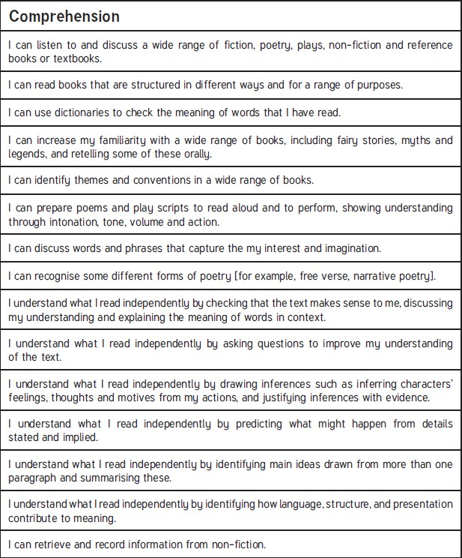
Lower Key Stage Two Year3

Slide 10
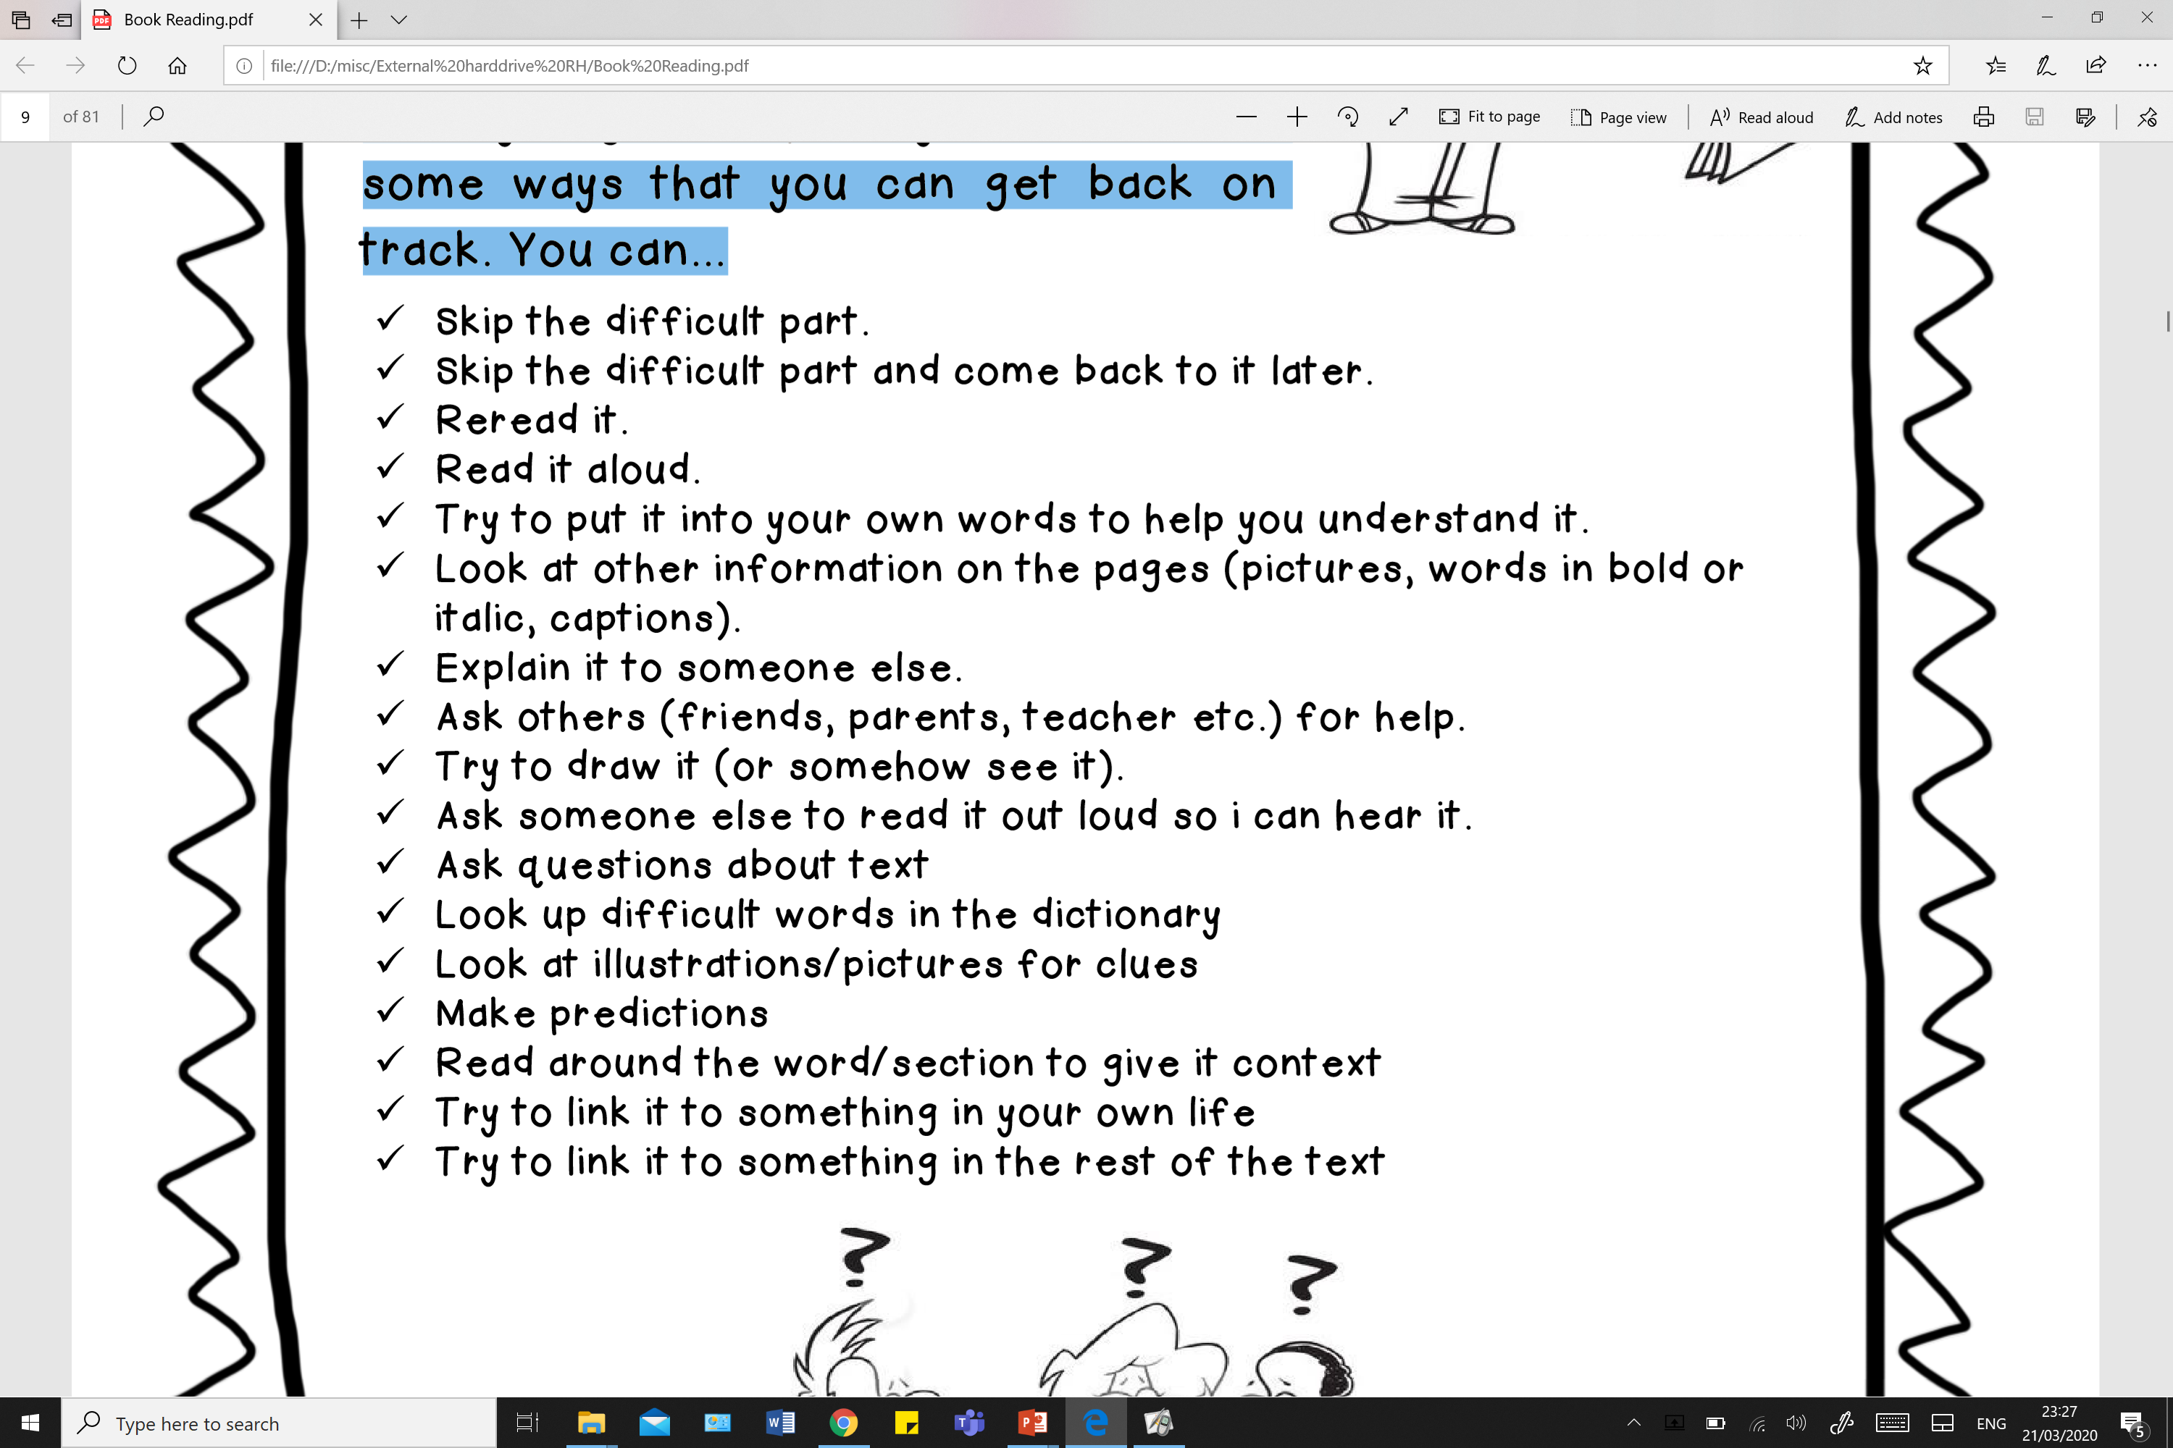


Strategies for reading
What to do when I get “stuck” when reading:

Slide 11
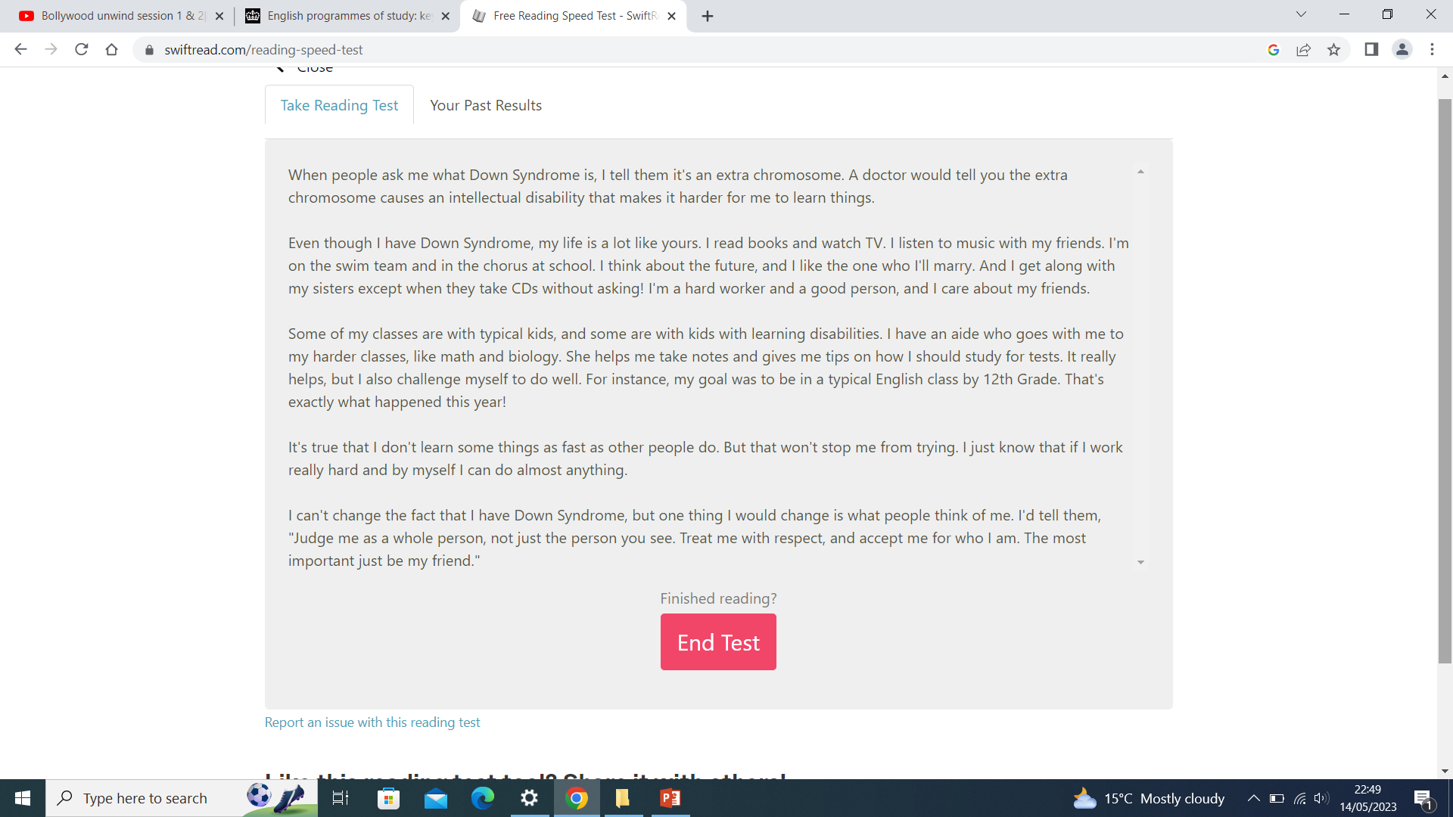

Slide 12
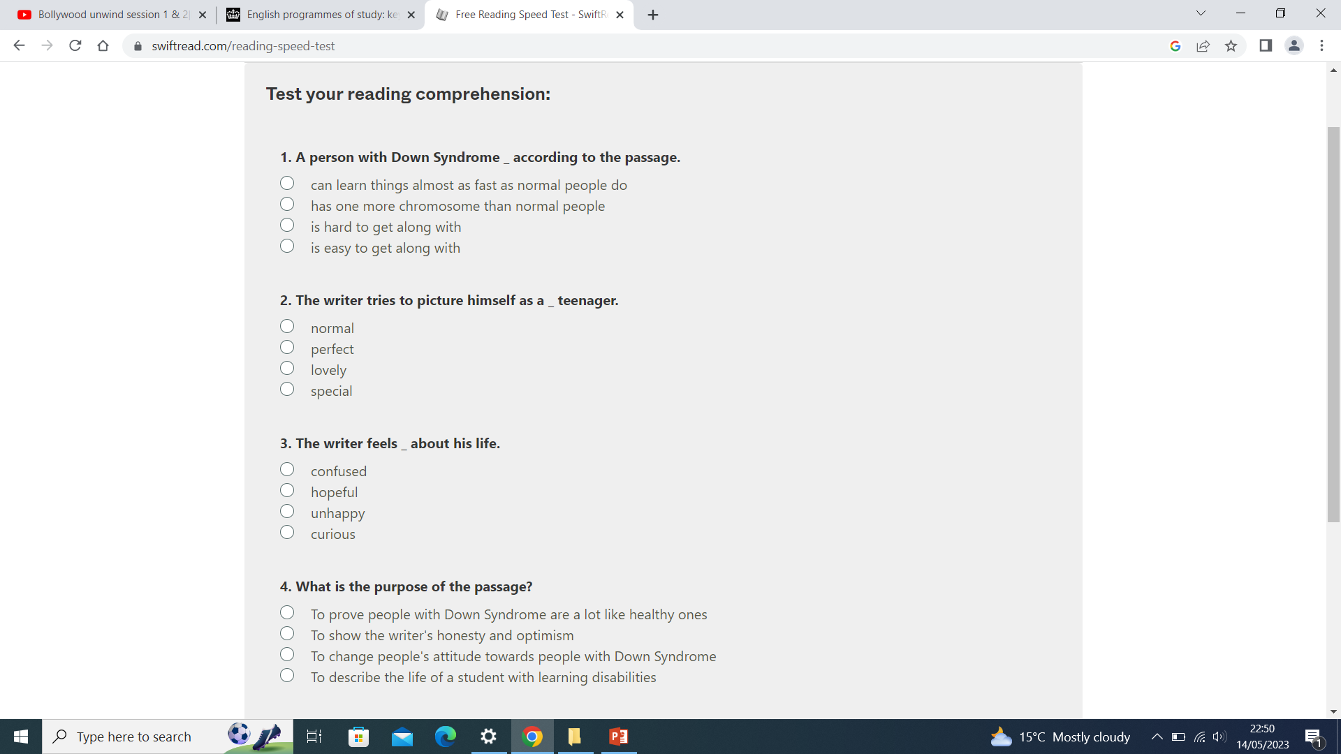

Slide 13
Reading Bands
Book changing

Slide 14
Reciprocal Reading
Taught as a whole class.
Activities differentiated

Slide 15

Day 1 - Text Marking
1.) Looking Question: What can you see?
2.) Clue Question: Who is sad? How do you know?
3.) Thinking Question: Why is the picture grey?
Extension Question: What do you think the book is going to be about?

Slide 16
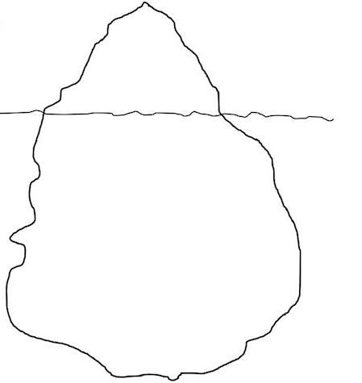
A Character iceberg is used to explore characteristics of people or characters in fiction.
The section above the water are things that can be observed e.g. colour of hair, how they dress,….
…and below the water line are things that cannot be seen e.g. behaviours, beliefs etc.

Slide 17
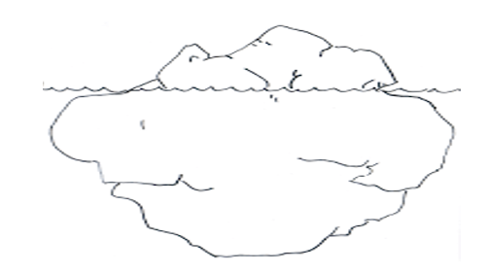
Day 2 – Character Iceberg
LI: To understand what I have read by using a text to make inferences about a character
What I know
What I think

Slide 18

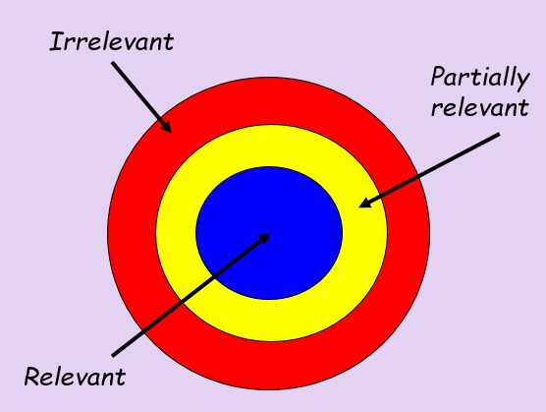
What is the Zone of relevance?
LI: To explain the meaning of words in context

Slide 19

LI: To explain the meaning of words in context
How relevant are these descriptive words in describing Michael Rosen’s? – (please use a dictionary if your are unsure of any words)
Heartfelt Angry Tender Emotional Melancholy
Determined Bitter Compassionate Elated Curious
Mad Calm Thoughtful Kind-hearted Positive Optimistic

Slide 20
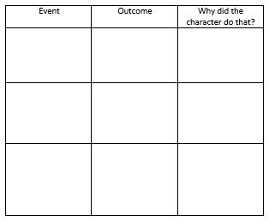
LI: To retrieve and record information from the text
Day 4 – Cause and effect
Put the main events in the cause and effect.

Slide 21

In Year 3 children will read 270 words of an age appropriate text in three minutes. In Year 4 children will read 360 words of an age appropriate text in four minutes. In Year 5 children will read 450 words of an age appropriate text in five minutes

Slide 22

Writing

Slide 23
English Lessons in Year 3
 | Autumn 1 | Autumn 2 | Spring 1 | Spring 2 | Summer 1 | Summer 2
English | Narrative | Diary Entry Poetry – Shape Poems | Iron Man Letter | Speech/ Monologue World Literature | Narrative | Non-Chronological Report linked to Geography Topic
Key Text | The Tear Thief | The Hodgeheg | The Iron Man | Georges Marvellous Medicine | Dinosaur Trouble | The Pebble in My Pocket
National curriculum in England: English programmes of study - GOV.UK (www.gov.uk)

Slide 24

The key areas of writing
Content
Punctuation
Grammar
Spelling
Handwriting
How do you help with this at home?

Slide 25
Spellings
Common exception words (Tricky words)
Practise spellings for the week, keep revising them.
Reading!
Checking children’s work and highlighting any spelling mistakes

Slide 26
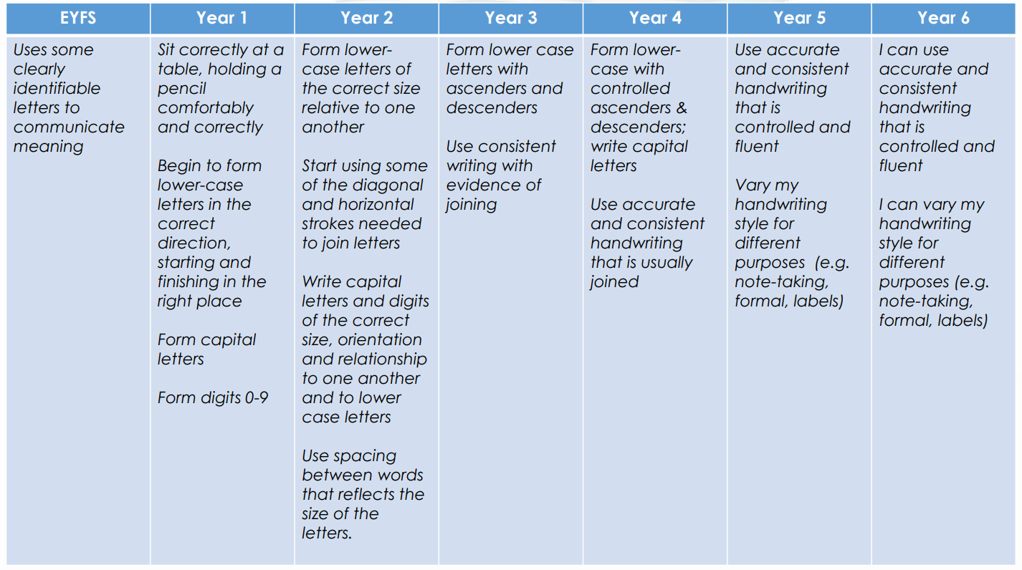
Handwriting

Slide 27
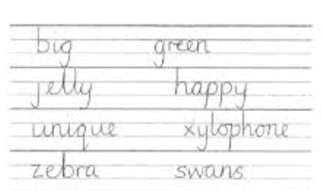
Ascender
Descender
These are important elements for handwriting.

Slide 28
Expectations - Content
Including expanded noun phrases to describe and add detail to writing.
What is an expanded noun phrase? - BBC Bitesize
The large, red door
The small, fluffy mouse
Add detail to make my writing more interesting
To vary openers
To add WOW words, using similes
Writing different genres- letters, stories, poems, newspapers

Slide 29
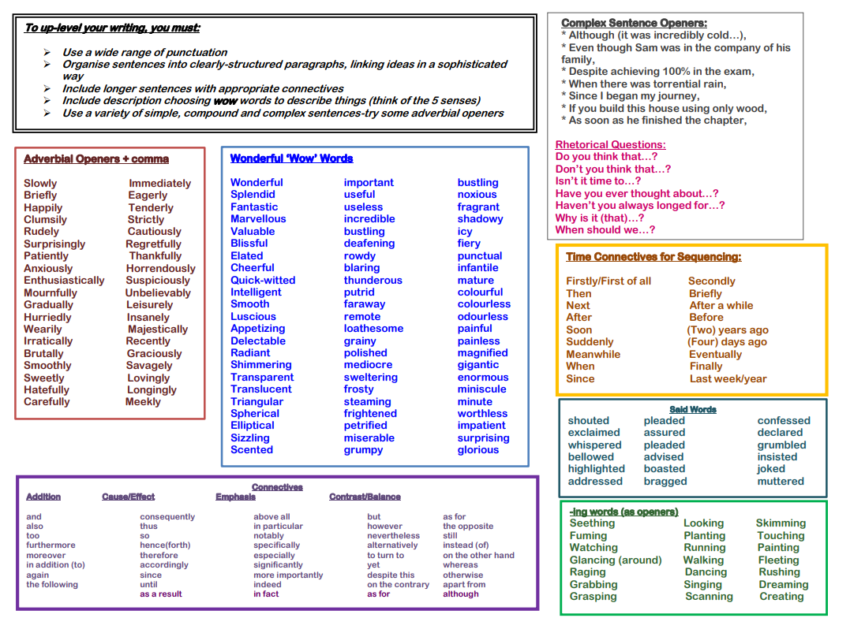
As part of our English lessons, we always give children opportunities to check and edit work, they have a range of word mats available to them to support with this.

Slide 30
How to support content, vocabulary and ideas for writing
Reading regularly! Reading gives ideas for writing.
Reading a range of genres.
Talk- discussing and sharing ideas before writing. This could be through a brainstorm, list or words or ideas, key words on cards.
Free writing- no specific genre.
Writing for a purpose- lists, letters to relatives, invitations, diaries.
Get children involved in your writing- why do you write?
Write alongside the child- ask them to be the teacher!
Assessing the writing together- where could we make our work better?
Model writing and your own ideas.

Slide 31
Punctuation…
Full stops and capital letters
Question marks and exclamation marks
Apostrophes for possession and contraction

Slide 32
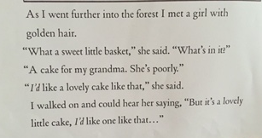
Into the forest….
Here are some examples

Slide 33
How to support your child with punctuation…
Reading- looking at examples of the punctuation in the story or other genre.
Discuss why we use these punctuation forms in their writing- do they know how to go back to their work and put it in? Do it together.
What would you say to your child if they wrote a sentence like this?
have you got the time ben?
spain and italy are both countries.

Slide 34
How to support your child with punctuation…
Useful websites-
Punctuation - KS2 English - BBC Bitesize
Top Marks
Punctuation, English Games for 5-7 Years – Topmarks

Slide 35
How to support grammar at home
Reading- looking at examples of how the conjunctions are used
Working together to mark their work
Creating a checklist of things to include in their work
Writing sentences together using an exciting stimulus
Conjunctions- and, but, so
Sometimes use conjunctions- when, if, that because
Present and past tense

Slide 36
How to help at home?
Year 3 Creative Writing Overview Guide – YouTube

Slide 37
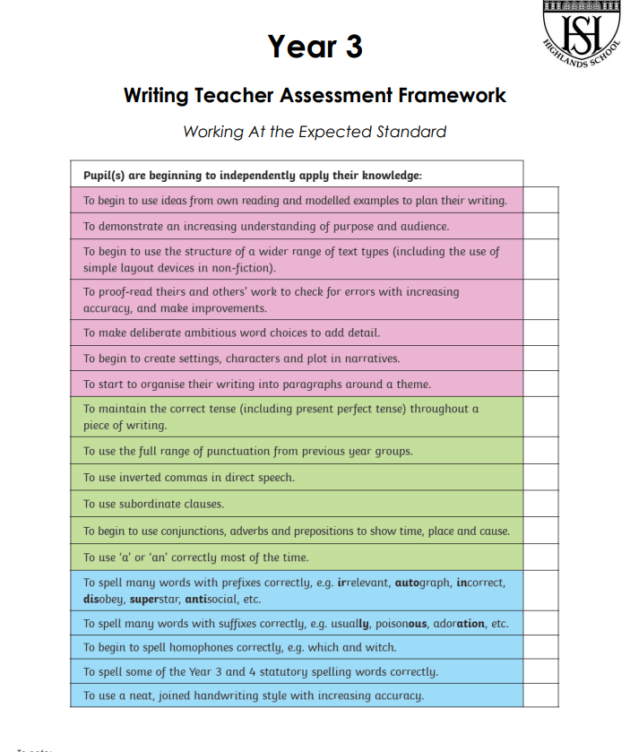
Writing Assessment

Slide 38
Thank you for coming!
You have a small speech bubble in your pack. If you have any questions please write it down and we will produce a FAQ document with responses and publish on school website in the Year 3 section.
A reminder of class inbox details:
  Mrs Sri/Mrs Shah – 3sr@highlandsprimary.net
  Mrs Gani – 3ga@highlandsprimary.net
  Mr Choudhury – 3ch@highlandsprimary.net

