Slide 1
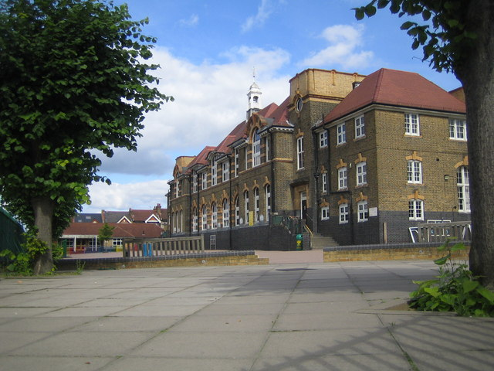
Highlands Primary School
14th September 2023
Meet the Teacher

Slide 2
PE Days
Class | PE Days
3Ga | Monday and Wednesday
3sr | Monday and Friday
3Ch | Monday and Friday
Please make sure your child comes to school in the correct PE kit on the days that they have PE.
Notes:
In line with the school attendance policy and local authority guidance we will be reinstating penalty fines for any leave that is taken during term time.
School staff monitor attendance very closely and will identify trends in unauthorised absences. We will explore these further through conversations with families where necessary.

Slide 3
Year Group
Year 3 will go swimming in Spring and Summer Term. This will count as a P.E lesson. You will receive a detailed letter closer to the time!
Tuck Shop
Swimming
Reading Books
All children will be allocated a reading book based on their reading band. Although children will be allocated a book-changing day, this is not fixed as some children may be reading longer or shorter books. All children will have the reading folder available to change their books as and when they need to. This will be recorded in our reading folder as well as their Reading Record. Please take the time to read with your child and write a comment in their reading record.
Notes:
Please let us know if there is a change to the person who will be collecting your child from school. If your child has had an injury outside of school, please bring them to the office as a risk assessment will need to be completed before they can go to class.

Slide 4
Thank You!

